Slide 1


Preventing Safety Compliance Issues
Combining technology, organizational structure, and regulatory approaches.
Steven Beales,
SVP, Scientific and Regulatory
WCG Clinical

Slide 2
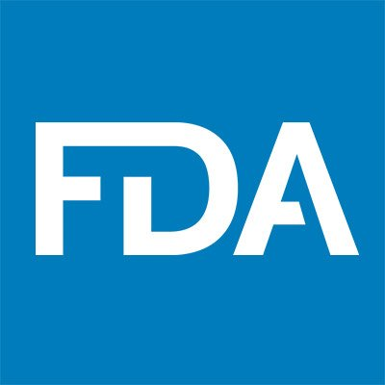






Safety Reporting Harmonization Working Group
Top 1 US Pharma
Top 1 EU Pharma
Top 2 Japan Pharma
Top 1 US IRB
Top 2 US CRO
Top 1 US Biotech
Notes:
This is the best time for clinical research that I can remember. Everyone is looking to our industry for hope, physical, mental, and economic well-being, and to save lives. It is also the most stressful time we can remember. I hope that everyone is doing as well as they can today.
We've saved some of the best content till last because you deserve it. Only the top 10% of employees attend conferences like this and only the top 1% stay for the last session. Our goal in this talk is to empower people like yourselves who are passionate about making a difference and enable you to be superstars in your own organizations.
I’m Steven Beales from WCG. I’ve spent the last 10 years building global safety reporting systems with some of the most brilliant companies in our industry.
I co-chair the Safety Reporting Harmonization Working Group with experts from the largest US, European and Japanese biopharmas, as well as the largest US CROs and IRBs.
Our mission is to -
1) Drive global harmonization in reporting rules for Competent Authorities, Investigators and Ethics Committees by creating a reference model of global safety reporting rules
2) Optimize the end to end process flows of safety reporting between all parties in our shared responsibility for patient safety.
3) Provide the roadmap to global touchless safety reporting and eliminate unnecessary manual work from safety reporting for all participants burdened by current processes.

Slide 3
What is the Function of the Working Group?
What is the Function of Working Group?
Global Harmonization
Clear Rules
Defined Accountability
Consistent Application
Precision Distribution
Standardized Process
“Codified” Country Rules
Compound Level
Unburdened Resources
Sites/IRB/IECs
Study Teams
Monitors
Quality Oversight
Process and Procedures
Transparency & Monitoring
Compliance
Notes:
What is the function of the Working Group?
We are sharing with you a proven approach that has been implemented at many of the top 10 pharma worldwide, which you can apply with confidence in your own organization. Without this guide, it’s daunting to know where to start with assuring compliance across Drug Safety and Clinical Operations and not to repeat some of the mistakes we made.
The 4 most important steps in this approach are
Global Harmonization – Understanding how we produce safety letters internally, controlling how we interpret country rules, defining our accountabilities and applying it consistently across all our studies.
Precision Distribution – Understanding that management of a compound's safety profile is a compound, not a study level, accountability and to structure not just our case processing but also our reporting to sites accordingly. Sites work with so many teams that managing it within a study subjects them to over distribution and fragmentation.
Unburdening Resources – Focusing on the roles who produce safety letters, those who receive safety letters and those accountable for site and study management and reducing the work they need to do through technology
Quality Oversight – Building in quality oversight activities to ensure the sustainability of the solution and ensure compliance by putting in controls on country rules and role-based training.

Slide 4

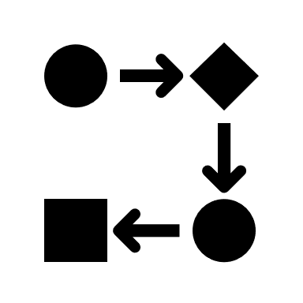

Global Safety Reporting Challenges
No Standards
Unclear Regulations
Conflicting Interpretations
Notes:
When we embarked on this journey 10 years ago, we did not expect that the main challenges in Global Safety Reporting would remain the same today.
There are still no existing global standards for distributing safety reports to investigators, ethics committees, and competent authorities.
Each country uniquely regulates when and how interested parties receive safety reports – When the working group catalogued the variations, we found over 40 different approaches.
Biopharmas interpret local country rules themselves to decide what safety information should be distributed in each country. Every biopharma defines what safety reports they will generate and how they will aggregate that information.

Slide 5



Consequences of Lack of Global Harmonization
Regulatory Repercussions
Fractured Accountability
Increased Costs
Notes:
As clinical research becomes more global, this lack of global harmonization has become the No.1 safety reporting problem for Sponsors.
The No.2 Safety Reporting problem for Sponsors is that Sponsors live in fear of regulatory repercussions and changing regulations, because rules and practices vary from country to country.
It is increasingly difficult to understand in each country the role the Sponsor plays in coordination with the competent authority, the investigators, the ethics committees or safety monitoring committees in sharing patient safety responsibilities.

Slide 6



Our Solution - Safety Reporting Reference Model
125 Countries
7800 Country Rules
Quarterly Updates
Notes:
What is our solution to the global harmonization problem?
We were pleased to release our first working group deliverable at end of last year - the safety reporting reference model version 1.0 for 125 countries and 63 different types of local rules.
We have catalogued all the variations in local laws that affect safety reporting and stored them in a rules database that can be used to power a safety reporting system.
The model contains over 7800 country rules but we managed to reduce every rule to a picklist of 3-5 options.
We will be publishing updates to this model every 6-12 months.
Although we hear a lot about data driven approaches and AI, a rules-based approach to automation will always perform better than a probabilistic one. We use machine learning when we're not smart enough to determine the rules ourselves and need to derive them from big data.

Slide 7
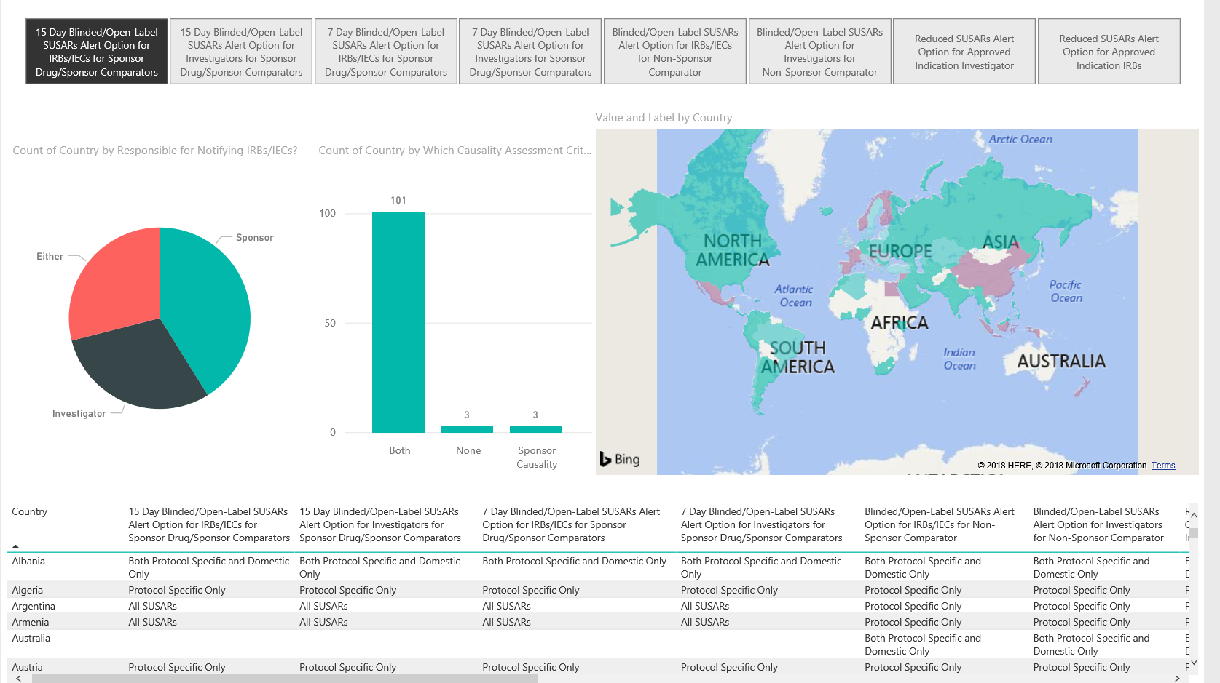
Global Expedited Reporting Rules
Global Expedited Reporting Rules
Notes:
As an example of the patterns we’ve found in our analysis, there are 5 different types of expedited reporting that occur in countries either All SUSARs are distributed, No SUSARs, Domestic Only SUSARs where only serious adverse reactions that occur in that country are reported to that country's own investigators, Protocol Specific (no cross reporting to other protocols on the compound) and Both Protocol Specific and Domestic Only (which is the most restrictive form of reporting).
Over 1/3rd of countries have some form of reduced expedited reporting.
If a sponsor sends SUSARs to all Sites and Ethics Committees, they are over-distributing by about 50% according to local laws.

Slide 8
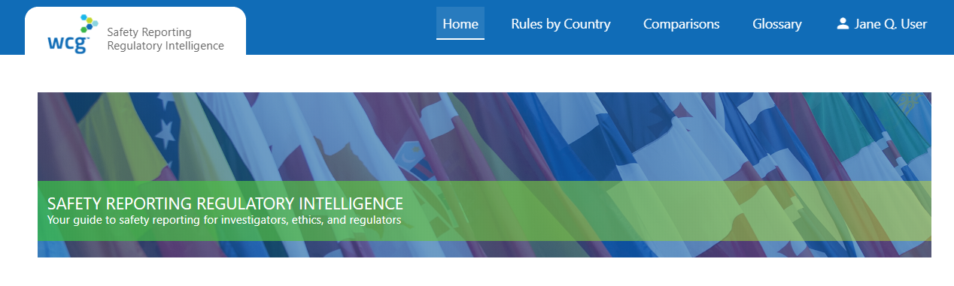
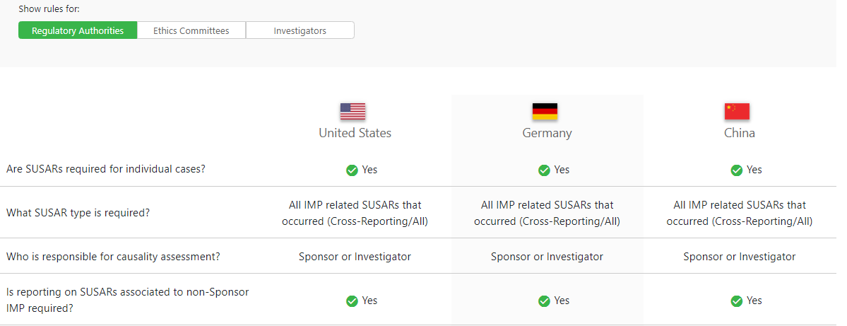
Safety Reporting Regulatory Intelligence
Safety Reporting
Regulatory Intelligence
Notes:
We've made this Safety Reporting Regulatory Intelligence available in a portal managed by the Working Group
The safety reporting reference model consists of
Oversight and Procedures e.g. Translation of regulations into checklists and implementable operational steps
Safety Document Characteristics e.g. rules for SUSARs, Reference Safety Information, and aggregate
Country Characteristics e.g. Unblinding requirements, Ethics Committee, Regulatory Authority and Investigator reporting requirements

Slide 9



Pressure of Clinical Trial Site Burdens
Too Many Reports
Duplicate Reports
Overly Time-consuming
Too Many Websites
Useful Information Hidden
Notes:
What about the perspective of sites?
Sites are overwhelmed with over-reported and cross-reported safety reports due to this “brute-force” distribution.
Many companies still distribute all safety reports to all Sites and Ethics Committees due to a literal interpretation of GCP instead of observing local laws.
The most common complaint from sites in the US on our Safety Reporting site survey is - “Why can’t sponsors get their act together and stop sending us SUSARs where there is no causal relationship to the drug?”

Slide 10
Why do Sites get Too Many Reports?
Why do Sites get Too Many Reports?
More THAN 20 PER MONTH
AVERAGE PER QUARTER
REFUSED TO PROCESS
80%
170
20%
Number of Safety Reports
Number of Sites
Notes:
80% of sites receive more than 20 SUSARs per month.
Average PI receives 170 safety letters per quarter. Median PI receives 85 per quarter.
You may be thinking that we don't have 170 SUSARs a quarter on any of our studies but it is the cross-reporting, where every SUSAR needs to be reported to every other study on that compound, that causes the numbers to rise.
We work with several companies that have seen a 5 fold increase in safety report distribution over last 3 years and for whom a single successful compound now has more safety distribution than the rest of their compounds combined.
20% of sites have refused to process a SUSAR because it was an over-distribution – a Safety Report that did not qualify as an unanticipated problem and did not need to be submitted to the IRB.
The FDA estimated 86% of SUSARs on 1 oncology trial did not qualify for expedited reporting.

Slide 11
What is Burden on Site Resources?
What is Burden on Site Resources?
1
1
61% SITES > 80 hours/month staff time
Including triage, review, forwarding, archiving and monitoring
2
2
$26 - ACTUAL SITE COSTS PER REPORT
Range from $17-$39, not including monitoring and annual archiving costs
3
3
$45 – AVERAGE SITE BUDGET PER REPORT
51% Gross Margin per Safety Report
Notes:
61% sites spend more than 80 hours of staff time on processing IND Safety Reports.
The average cost per safety report in labor was $26 not including any additional costs.
The average budgeted cost was $45 – so 1 unintended consequence is that sites can generate revenue by reading unnecessary safety reports at cost of not spending time with patients.

Slide 12



Our Solution - Precision Global Safety Reporting
Right Information
Right Time
Right Person
Notes:
Our solution to the over-distribution problem is Precision Global Safety Reporting.
We tried to envisage what would be the best possible invention for ClinOps and Drug Safety.
A lot of our work involves getting the right information or document to the right person at the right time anywhere in the world according to local laws and verifying that it was received.
We decided that we would build such a system and we envisaged it as being like a virtual Star Trek Transporter system beaming the right information to the right place with mission-critical precision because lives were at stake.
We finally achieved our goal and built the system we envisaged but it took many more years and was 10x more difficult than we naively imagined it would be.
I caution against trying to build your own safety reporting system or using one of the several vendors who offer safety reporting systems that have no built-in intelligence. These are just fancy email systems that do not address your compliance issues, help your sites or avoid costs – most of our working group did not understand the benefits of compound level reporting, country alerting rules, directing reporting to ECs, gap packs or touchless systems until we’d built a first generation system that was only partially successful.

Slide 13

Reduction in Safety Reporting Costs
Reduction in Safety Reporting Costs
$7,000 per Safety Report
Notes:
SO what do the results look like
We now have a couple of years of data at some of our largest working group members and the results over the last 2 years have been noteworthy -
By using local laws, the mean reduction in number of Safety Letters per Safety Report has been 51%.
Assuming site and CRO costs of $45 per Safety Letter, this has resulted in approximately a $7000 saving per Safety Report.

Slide 14
Critical Findings in GCP and PV Compliance
33% Sponsor TMFs inspected by MHRA in 2018
“Significant potential for SUSARs to go unreported.”
42% FINDINGS related to inability to locate documentation
Notes:
What role have the competent authorities focused on in assuring compliance between Pharmacovigilance and GCP?
33% of Sponsor TMFs inspected by MHRA in 2018 had critical findings. 100% had major findings.
42% of critical findings were related to inability to locate documentation or proof of specific activities within TMF or supporting systems.
2 serious TMF findings resulted in pharmacovigilance findings because general failure of TMF meant, “significant potential for Suspected Unexpected Serious Adverse Reactions (SUSARs) to go unreported.”
Many sponsors are an MHRA inspection away from at least a major finding.

Slide 15
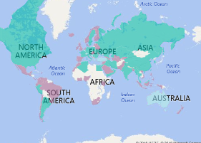
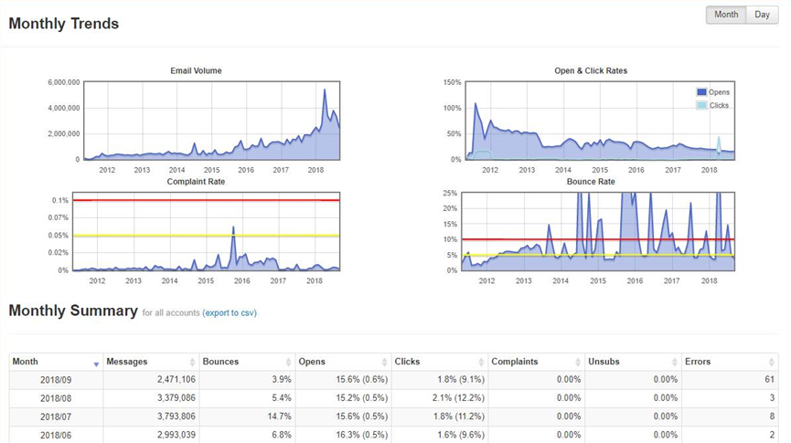
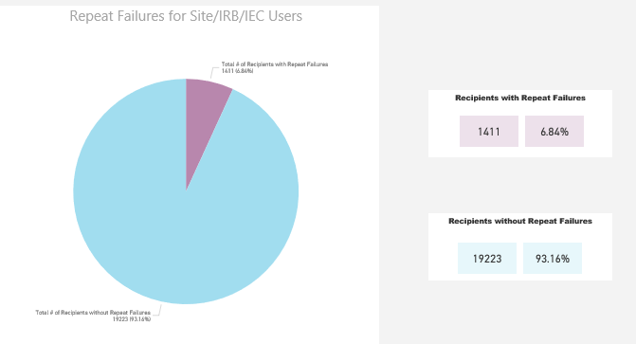
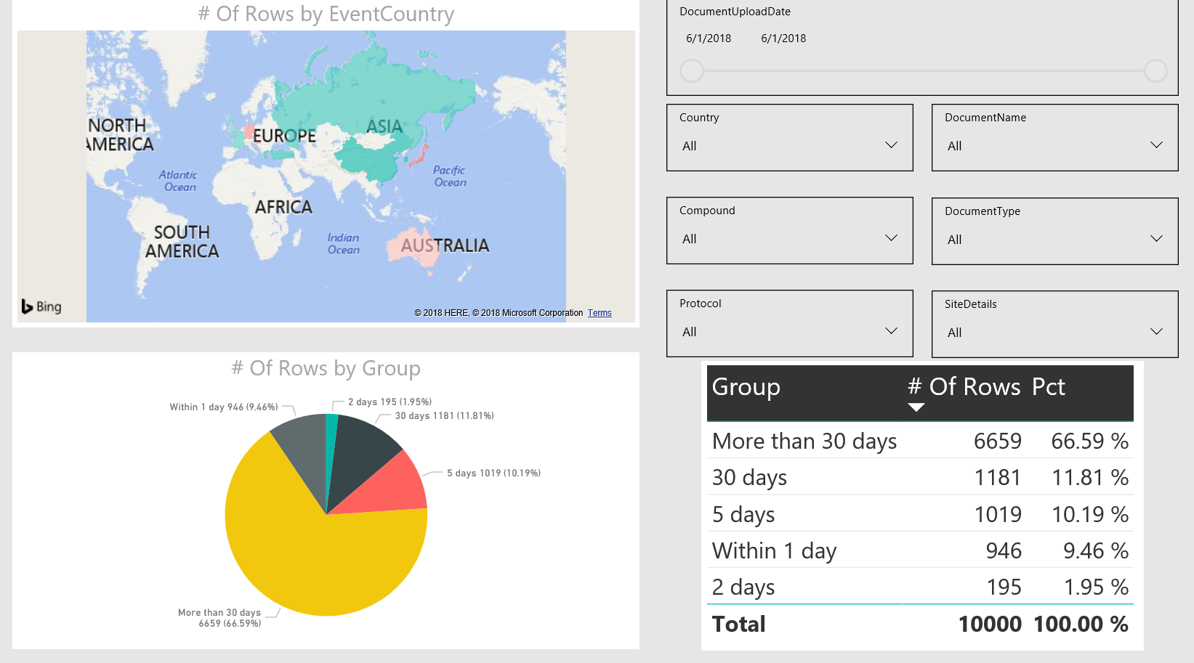
Our Solution - Safety Reporting Quality & Compliance
Safety Reporting Quality & Compliance
Country Rules and Amendments
Volume and target audience
Identify risk
How is the information being consumed?
Notes:
What is our solution to end to end safety reporting quality oversight and compliance?
Our working group sponsors have built dashboards that focus on what we can monitor and act upon.
Monitoring regulatory environment with our working group’s input for changes in country rules and regulations
Identifying risk by ensuring all sites follow training and safety requirements
Monitoring the transmission of safety alerts and ensuring that any email bounce backs are routed directly to the responsible person so they can be fixed in accordance with regulatory timelines.

Slide 16

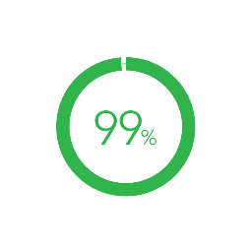
Reduction in Operational Burden
Costs
Avoided
Sites in Compliance
Reduction in Site Burden
175 - 450k
per trial
10 hours
per week
Notes:
What outcome can you expect for your organization if you implement our recommendations?
For the average phase 2 clinical trial, savings have ranged between $150k and $450k per trial.
Average reduction in Safety Reports per Site has been 5 safety letters per week or 5-10 hours per week
99% of sites have trained active users in system receiving delivery and have documented receipt of safety reports.

Slide 17
Benefits of Right-Sizing Safety Reporting
Improve Patient Safety
Make Sites Happier
Pass Inspections
Avoid Costs
Notes:
In summary, by transforming their approach to Global Safety Reporting operations, including global harmonization of the process, precision distribution according to local laws, global quality and regulatory oversight, a sponsor may
improve patient safety
reduce site and operational burden
bullet-proof compliance
avoid unnecessary costs.

Slide 18



Time For Action
Notes:
Change is never painful, only resistance to change is painful.
Please join with us and help us to build the safety reporting reference model.
May all our future global safety reporting be precise, compliant, and according to local law.

Slide 19

Ask Big Questions

Slide 20
Thank You
Steven Beales
SVP, Scientific and Regulatory
WCG Clinical
@stevenbeales
sbeales@wcgclinical.com

